Slide 1


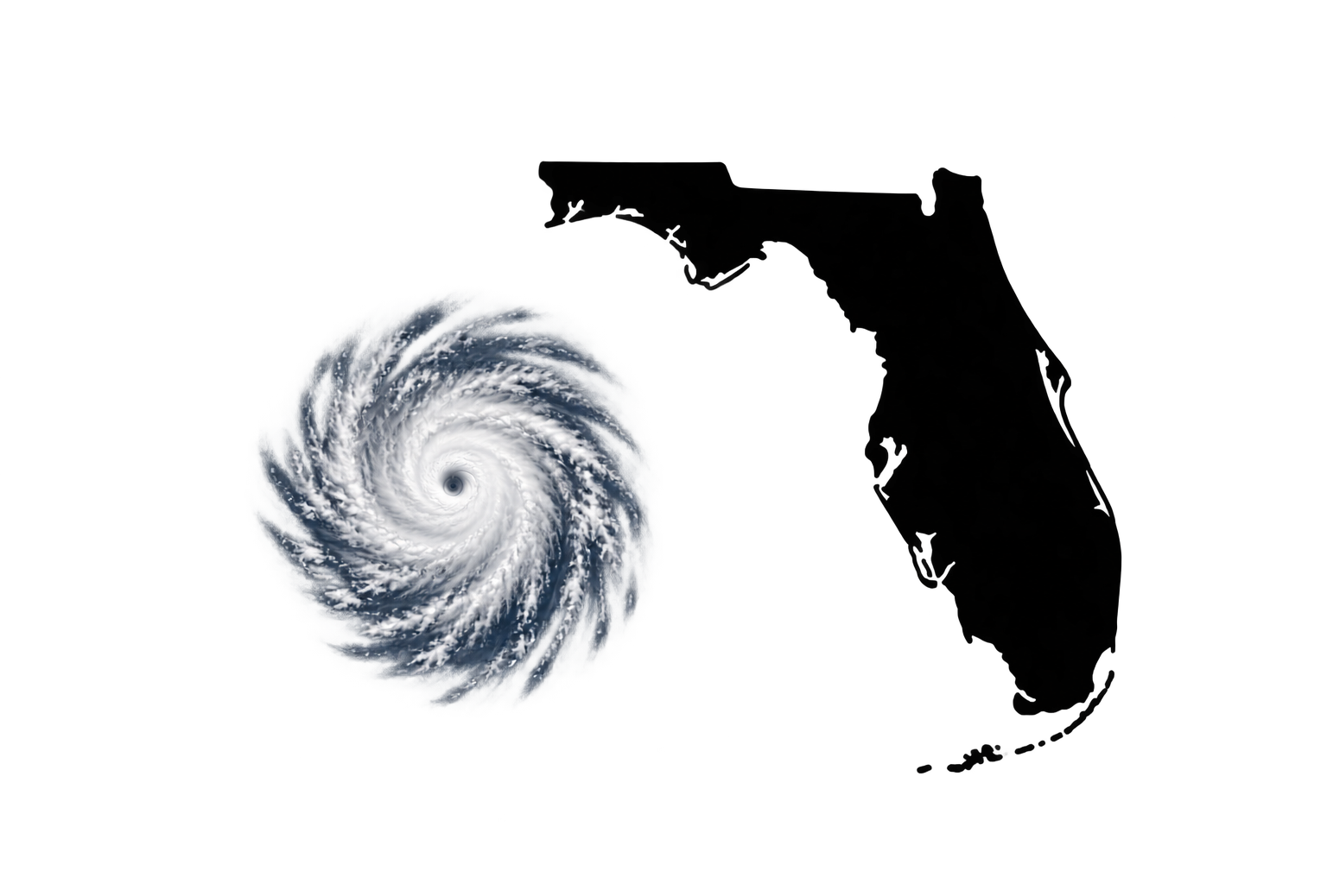
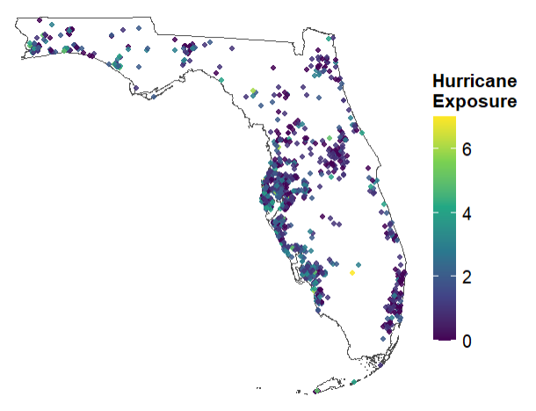
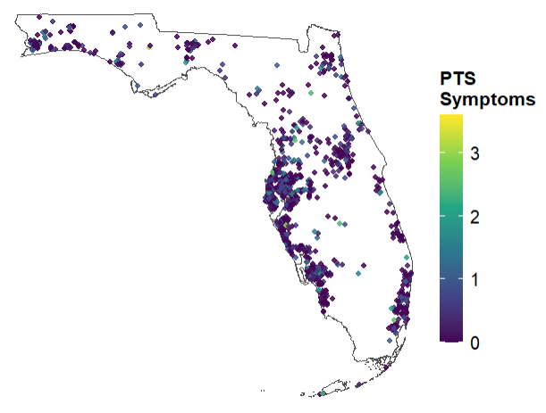
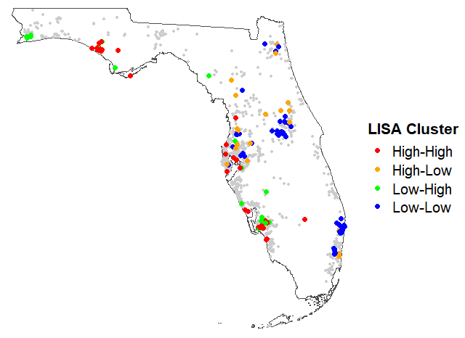
Spatial Clustering of Traumatic Experiences and Posttraumatic Stress Symptoms
Evidence from Hurricane-Exposed Adults in Florida
Soheil Shapouri, Dana Rose Garfin
Fielding School of Public Health, UCLA
Background
Hurricanes produce geographic hotspots of physical destruction and human exposure. Whether these spatial patterns extend to posttraumatic stress symptoms (PTS) remains unclear.
Hurricane exposure
clusters geographically.
Results
Descriptive Statistics
Participants were 18–99 years old (M = 62.7, SD = 14.36).
51.0% bachelor’s degree or above, 32.3% some college, 14.7% high school, and 1.9% less than high school.
59.1% were female and 40.9% male.
80.8% were White, 10.2% Hispanic, 6.4% Black, 1.4% multiracial, and 1.2% other race.
Hurricane exposure was spatially clustered, Global Moran’s I = .11, p < .001. Participants with similar levels of hurricane exposure tended to live near one another.
PTS symptoms were not spatially clustered, Global Moran’s I = −.001, p = .51. Participants with similar levels of PTS symptoms did not tend to live near one another.
Greater hurricane exposure was associated with greater PTS symptoms, r = .24, 95% CI [.19, .30], p < .001. Thus, exposure and PTS were associated at the individual level, despite showing different patterns of geographic clustering.
Objective
Examine whether hurricane exposure and PTS symptoms show spatial clustering across Florida.
PTS symptoms do not.
Method
Participants and procedure
Probability-based sample of 1,052 Florida adults from Ipsos KnowledgePanel; data collected April 30–May 19, 2025.
Measures
Hurricane exposure: 10 yes/no prior hurricane experiences (e.g., evacuation, property damage, injury) summed into a cumulative exposure score.
PTS symptoms: Five hurricane-related symptoms rated 0 (never)–4 (all the time) and averaged (modified PC-PTSD-5)
Spatial Analysis
Spatial neighbors defined using 8-nearest neighbors
Global Moran’s I assessed spatial autocorrelation
LISA (Local Indicators of Spatial Association) identified local hurricane-exposure clusters
Hurricane Exposure
Global Moran’s I = 0.11
p < .001
Significant positive spatial autocorrelation
PTS symptoms
Global Moran’s I = -0.001
p = .51
No evidence of spatial autocorrelation
Take-home message
Hurricane exposure forms geographic hotspots, but PTS symptoms do not; highlighting the need for geographically broad mental health screening beyond areas of greatest hurricane exposure.
Hurricane Exposure
PTS Symptoms
Hurricane Exposure Clusters
Each point represents a participant.
Color indicates cumulative hurricane exposure (0–7).
Each point represents a participant.
Color indicates PTS symptom severity.
High-exposure participants surrounded by other high-exposure participants
Low-exposure participants surrounded by other low-exposure participants
Notes:
Add actual QR code

